Slide 1
Patriarchal Age

Slide 2
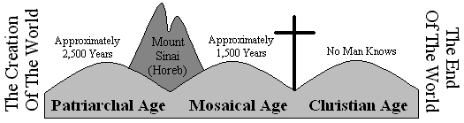
Biblical Time Line
Age of Fathers

Slide 3
Creation
Gen.1:1-3 In the beginning, God created…
  How do we know?
  Heb. 11:3 by faith
What is Faith?
  Heb. 11:1 Now faith is the substance of things hoped for, the evidence of things not seen. KJV
  Now faith is the assurance of things hoped for, the conviction of things not seen. ASV

Slide 4
Creation
God Created Mankind
  Gen. 2:7 And the LORD God formed man of the dust of the ground, and breathed into his nostrils the breath of life;
Man different… how?
  Gen. 2:7 …man became a living soul
  Matt. 10:28 And fear not them which kill the body, but are not able to kill the soul: but rather fear him which is able to destroy both soul and body in hell.

Slide 5
Creation
God Created Mankind
  Gen. 2:7 And the LORD God formed man of the dust of the ground, and breathed into his nostrils the breath of life;
Man different… how?
  Gen. 2:7 …man became a living soul
  Matt. 10:28 …fear him which is able to destroy both soul and body in hell.
  Matt. 16:26 For what is a man profited, if he shall gain the whole world, and lose his own soul? or what shall a man give in exchange for his soul?

Slide 6
Who/What should be fear?
Fear Not
Body - Soul =
Animal
Man
Satan
Fear
Body + Soul =
Satan?
GOD
Grave
Hell

Slide 7
Garden of Eden
Adam and Eve
Man Given Purpose
  Gen. 2:15 And the LORD God took the man, and put him into the garden of Eden to dress it and to keep it.
God Spoke
  Gen. 2:16-17 ¹⁶And the LORD God commanded the man, saying, Of every tree of the garden thou mayest freely eat: ¹⁷ But of the tree of the knowledge of good and evil, thou shalt not eat of it: for in the day that thou eatest thereof thou shalt surely die.

Slide 8
God Said: Thou shalt surely die!
Knowledge Good and Evil
Life

Slide 9
Garden of Eden
Satan Spoke –
  Gen. 3:1-6 ¹ Now the serpent was more subtil than any beast of the field which the LORD God had made. And he said unto the woman, Yea, hath God said, Ye shall not eat of every tree of the garden? ² And the woman said unto the serpent, We may eat of the fruit of the trees of the garden: ³ But of the fruit of the tree which is in the midst of the garden, God hath said, Ye shall not eat of it, neither shall ye touch it, lest ye die. ⁴ And the serpent said unto the woman, Ye shall not surely die: ⁵ For God doth know that in the day ye eat thereof, then your eyes shall be opened, and ye shall be as gods, knowing good and evil.

Slide 10
God Said: Thou shalt surely die!
Knowledge Good and Evil
Life
Satan said: Thou shalt not surely die!

Slide 11
Garden of Eden
Gen. 3:6 ⁶ And when the woman saw that the tree was good for food, and that it was pleasant to the eyes, and a tree to be desired to make one wise, she took of the fruit thereof, and did eat, and gave also unto her husband with her; and he did eat.
Eve was deceived; she believed a lie
Adam and Eve disobeyed God
  (1Jn. 3:4 = Sin)
Christ Promised

Slide 12
God Said: Thou shalt surely die!
Knowledge Good and Evil
Life
1 John 3:4 - Sin
Satan said: Thou shalt not surely die!

Slide 13
Cain and Abel
Gen. 4:1-5 ¹ And Adam knew Eve his wife; and she conceived, and bare Cain, and said, I have gotten a man from the LORD. ² And she again bare his brother Abel. And Abel was a keeper of sheep, but Cain was a tiller of the ground. ³ And in process of time it came to pass, that Cain brought of the fruit of the ground an offering unto the LORD. ⁴ And Abel, he also brought of the firstlings of his flock and of the fat thereof.

Slide 14
God
Veggies
Lamb - Blood
Worship
Cain - Farmer
Abel - Shepherd

Slide 15
Cain and Abel
Gen. 4:1-5 ¹ And Adam knew Eve his wife; and she conceived, and bare Cain, and said, I have gotten a man from the LORD. ² And she again bare his brother Abel. And Abel was a keeper of sheep, but Cain was a tiller of the ground. ³ And in process of time it came to pass, that Cain brought of the fruit of the ground an offering unto the LORD. ⁴ And Abel, he also brought of the firstlings of his flock and of the fat thereof. And the LORD had respect unto Abel and to his offering: ⁵ But unto Cain and to his offering he had not respect. And Cain was very wroth, and his countenance fell.

Slide 16
Had Respect
Had Not Respect
Accepted
God
Rejected
Rom. 10:17
1 John 3:12
Veggies
Lamb - Blood
Worship
Cain - Farmer
Abel - Shepherd
Conscience Prov. 14:12,
Faith Heb. 11:4
Matt. 7:21-23
Not all will enter into heaven

Slide 17
Cain and Abel
Cain, like us, just needed to give God worship according to what God asked for!
  Gen. 4:6-8 ⁶ And the LORD said unto Cain, Why art thou wroth? and why is thy countenance fallen? ⁷ If thou doest well, shalt thou not be accepted? and if thou doest not well, sin lieth at the door. And unto thee shall be his desire, and thou shalt rule over him.
  ⁸ And Cain talked with Abel his brother: and it came to pass, when they were in the field, that Cain rose up against Abel his brother, and slew him.

Slide 18
Cain and Abel
Why is worship from conscience wrong?
  1 John 3:12 ¹² Not as Cain, who was of that wicked one, and slew his brother. And wherefore slew he him? Because his own works were evil, and his brother’s righteous.
Not all religious will enter heaven.
  Matt. 7:21-23 ²¹ Not every one that saith unto me, Lord, Lord, shall enter into the kingdom of heaven; but he that doeth the will of my Father which is in heaven. ²² Many will say to me in that day, Lord, Lord, have we not prophesied in thy name? and in thy name have cast out devils? and in thy name done many wonderful works? ²³ And then will I profess unto them, I never knew you: depart from me, ye that work iniquity.

Slide 19
Flood
Gen. 6:5-7 ⁵ And GOD saw that the wickedness of man was great in the earth, and that every imagination of the thoughts of his heart was only evil continually. ⁶ And it repented the LORD that he had made man on the earth, and it grieved him at his heart. ⁷ And the LORD said, I will destroy man whom I have created from the face of the earth; both man, and beast, and the creeping thing, and the fowls of the air; for it repenteth me that I have made them.
Repent: to have a change of heart strong enough to cause a change in action.
God was ready to undo the creation of man – he had a change of heart strong enough to cause a change in his action.

Slide 20
Flood
Gen. 6:5-7 ⁵ And GOD saw that the wickedness of man was great in the earth, and that every imagination of the thoughts of his heart was only evil continually. ⁶ And it repented the LORD that he had made man on the earth, and it grieved him at his heart. ⁷ And the LORD said, I will destroy man whom I have created from the face of the earth; both man, and beast, and the creeping thing, and the fowls of the air; for it repenteth me that I have made them.
Verse 8- ⁸ But Noah found grace in the eyes of the LORD.
Gen. 6:3-16 Ark is prepared by God's plan = 450ft. long x 75ft. wide x 45ft. high

Slide 21
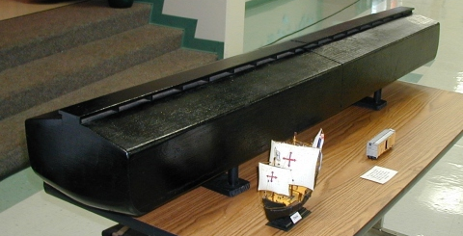
Noah’s Ark
1/75 scale
The Ark approximately 450ft. long x 75ft. wide x 45ft. high
Noah/family/animals went in-Door was shut no more opportunities:

Slide 22
Flood
Why did Noah build an Ark?
  Heb. 11:7 ⁷ By faith Noah, being warned of God of things not seen as yet, moved with fear, prepared an ark to the saving of his house; by the which he condemned the world, and became heir of the righteousness which is by faith.
  Gen. 6:22 ²² Thus did Noah; according to all that God commanded him, so did he.
  1 Pet. 3:20 ²⁰ Which sometime were disobedient, when once the longsuffering of God waited in the days of Noah, while the ark was a preparing, wherein few, that is, eight souls were saved by water.

Slide 23
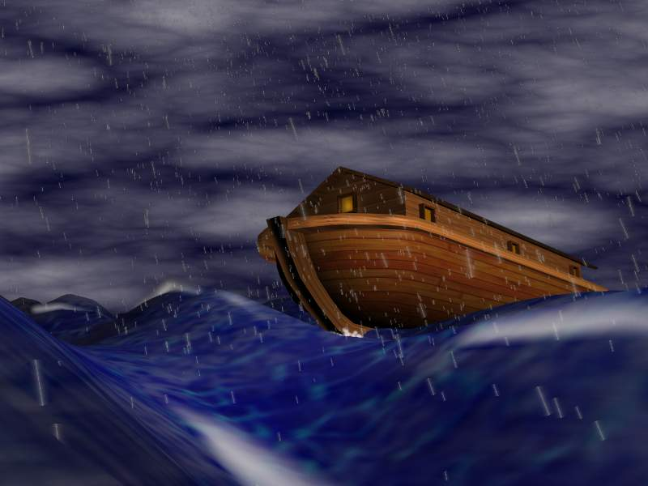
Noah’s Ark
Sin and Wickedness washed away

Slide 24
God’s Plan for Noah
God’s Grace (Gen. 6:8)
Noah’s Faith (Heb. 11:7)
Noah’s Obedience (Gen. 6:22)
God’s Cleansing by Water (1Pet. 3:20)

Slide 25
Earth’s Next Destruction
Next by fire:
  2 Pet. 3:9-14 ⁹ The Lord is not slack concerning his promise, as some men count slackness; but is longsuffering to us-ward, not willing that any should perish, but that all should come to repentance. ¹⁰ But the day of the Lord will come as a thief in the night; in the which the heavens shall pass away with a great noise, and the elements shall melt with fervent heat, the earth also and the works that are therein shall be burned up. …

Slide 26
Earth’s Next Destruction
Next by fire:
  2 Pet. 3:9-14 …¹¹ Seeing then that all these things shall be dissolved, what manner of persons ought ye to be in all holy conversation and godliness, ¹² Looking for and hasting unto the coming of the day of God, wherein the heavens being on fire shall be dissolved, and the elements shall melt with fervent heat? ¹³ Nevertheless we, according to his promise, look for new heavens and a new earth, wherein dwelleth righteousness. ¹⁴ Wherefore, beloved, seeing that ye look for such things, be diligent that ye may be found of him in peace, without spot, and blameless.

Slide 27
Promises
Abraham:
  Gen. 12:1-3
Land Gen. 13:14,15
National: Israel
Spiritual: Gal. 3:16
Our Promises
  2 Pet. 1:3-4
Land Heb.11:16
National 1Pet. 2:9
Spiritual Rom. 8:14

Slide 28
Sodom & Gomorrah
Gen. 13:13, 19:12-29
  God warned Lot.
  God had a plan for Lot.
    Positive command: Escape for thy life
    Negative command: Look not behind thee
  2 Pet. 2:4-6, 9

Slide 29
Linage of Abraham
Abraham = Isaac = Jacob –
(Israel – Gen. 35:10) had 12 sons:
  Rueben, Simeon, Levi, Judah, Dan, Naphtali, Gad, Asher, Issachar, Zebulun, Joseph, Benjamin

Slide 30
Moses
Raised as son to Pharaoh
  By mother
At age 40 ran for his life for death of Egyptian
Tended sheep for 40 years
At age 80 returned to lead God’s people out of Egypt.

Slide 31
Moses
10 plagues
Parting of the Red Sea
Leading to Mount Sinai.

