Slide 1
Survey Questions
If you died tonight, would you go to heaven?
Yes No I don’t know
Are you saved?
Yes No I don’t know

Slide 2
Survey Questions
How were you saved?
Write your story.
Have you been baptized?
Yes No I don’t know
Were you baptized before or after salvation?

Slide 3
Christian Age
Age of Christ: Gospel

Slide 4
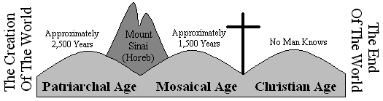
New Testament Christianity

Slide 5
Salvation
Who Saves?
Jesus
What Saves US?
Blood of Jesus
When Are We Saved?

Slide 6
Jesus Saves!
Jesus Loves Us!
Who does he save?
Luke 19:10
Rom. 3:23 Rom. 6:23
What are we saved from?
Matt. 1:21
Why does he want to save us?
John 3:16

Slide 7
We are Saved by…
Romans 1:16
The Power of God
1 Cor. 15:1-4
The Gospel
Gospel
Good News

Slide 8
Gospel (Good News)
of Jesus Christ
1 Cor. 15:1-4
Resurrection
Death
Burial

Slide 9
1 Peter 4:17-18
Judgment
House of God
Obey Gospel
Saved
Not in house of God
Obey Not Gospel
Ungodly & Sinner

Slide 10
2 Thessalonians 1:7-10
Judgment
Jesus and His Mighty Angels
Saved Know God and Obey the Gospel
Rest
Glorified
Know not God and Obey Not the Gospel
Flaming Fire in Vengeance
Punished with Everlasting Destruction

Slide 11
How do we obey the Gospel?
Hear
John 10:27
Romans 10:17
Believe
John 3:16,17
James 2:19
Repent
Luke 13:3
Confess
Baptized
Mark 2:17
Matthew 10:32,33
John 12:42,43
Mark 16:16
Matthew 28:18-20

Slide 12
Examples of Obedience to Salvation
Example | Scripture | Hear | Believe | Repent | Confess | Baptized
Jews at Jerusalem | Acts 2:37-41
Eunuch | Acts 8:35-39
Philippian Jailer | Acts 16:30-34
Disciples of John | Acts 19:1-6
Saul/Peter | Acts 22:10-16

Slide 13
Romans 6:3-4
Baptized
=Burial
Into Death

Slide 14
That Form of Doctrine
Romans 6:17,18 Obeyed from the heart
Death
Burial
Resurrection

Slide 15
That Form of Doctrine
1 Peter 1:17-18 Redeemed by blood
Resurrection
Death
Burial

Slide 16
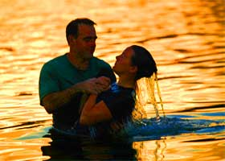
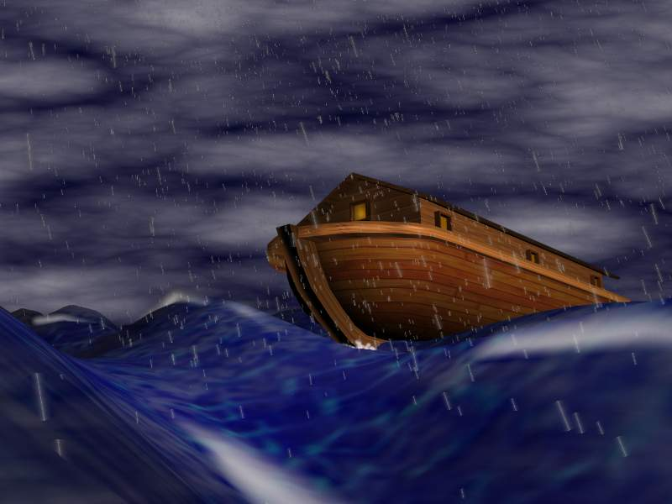
1 Peter 3:21
1 Peter 3:20
The like figure whereunto even baptism doth also now save us (not the putting away of the filth of the flesh, but the answer of a good conscience toward God,) by the resurrection of Jesus Christ:
Which sometime were disobedient, when once the longsuffering of God waited in the days of Noah, while the ark was a preparing, wherein few, that is, eight souls were saved by water.
Sin and Wickedness washed away

Slide 17
1 Peter 3:21
The like figure whereunto even baptism doth also now save us (not the putting away of the filth of the flesh, but the answer of a good conscience toward God,) by the resurrection of Jesus Christ:
Sin and Wickedness washed away

Slide 18
God’s Plan
Noah | Plan | Christian
 | Grace
 | Faith
 | Obedience
 | Water
Gen. 6:8
Eph. 2:5
Heb. 11:7
Eph. 2:8
Gen. 6:22
Heb. 5:9
1 Pet. 3:20
1 Pet. 3:21

Slide 19
1 Peter 3:21
Colossians 2:12
Buried with him in baptism, wherein also ye are risen with him through the faith of the operation of God, who hath raised him from the dead.
The like figure whereunto even baptism doth also now save us (not the putting away of the filth of the flesh, but the answer of a good conscience toward God,) by the resurrection of Jesus Christ:
Faith is obedience towards God

Slide 20
Have you obeyed?
Faith is obedience towards God

